Slide 1
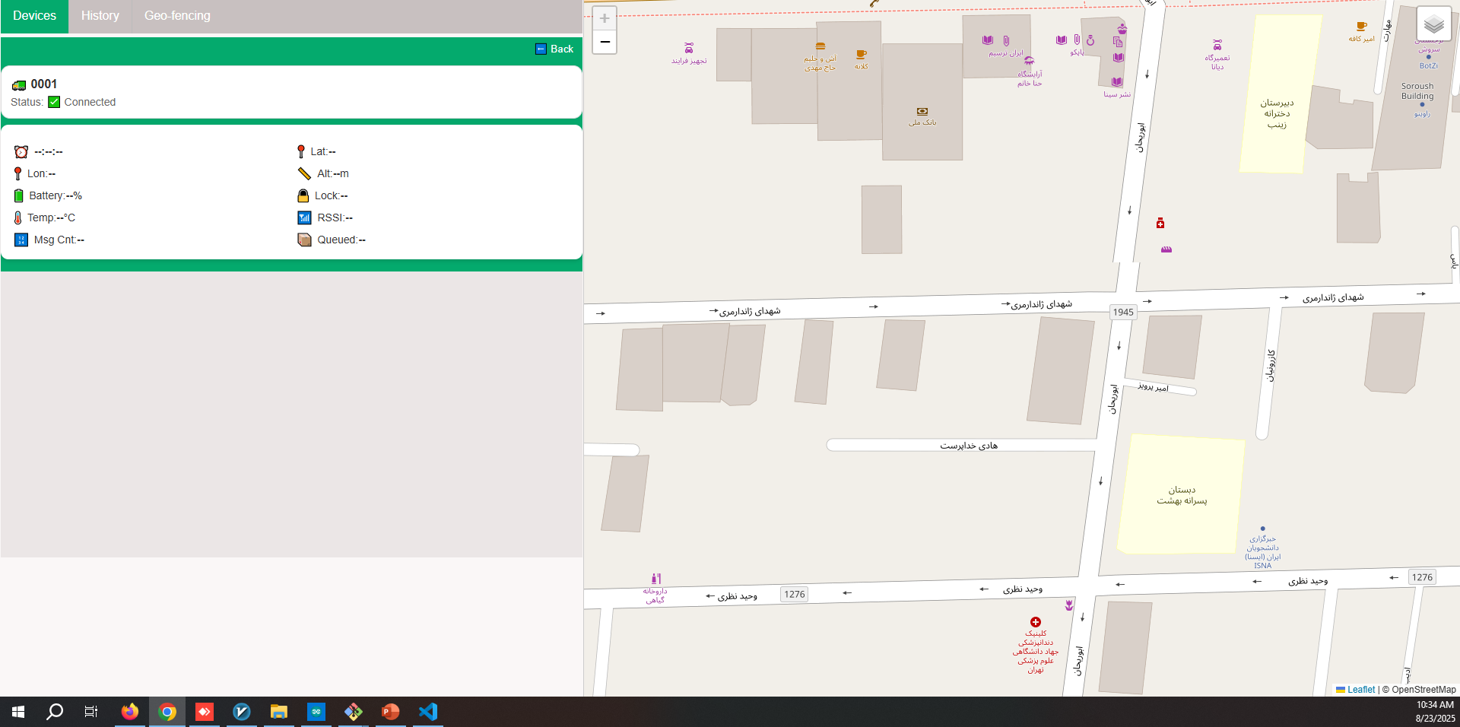



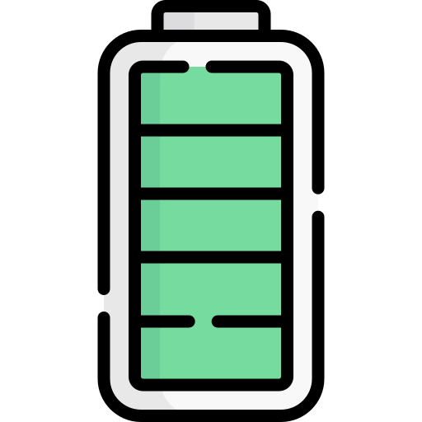





Time: --:--:--
Latitude: -
Longitude: -
Lock status
Battery: --%
RFID: serial number
Last attempt: --:--:--
Zone:
Zone name/No Specified Zone
Lock Command
Wake-Up Interval Time

